Slide 1
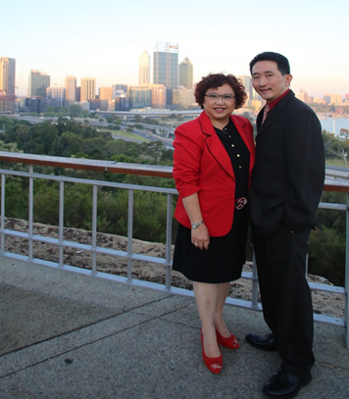
Business building Principles for all UFOs
Sabrina Chai
National Supervising Coordinator
(earned A$10,000 - $15,000 in 4 week pay cycle)

Slide 2
My Stumbling blocks
Small mindset - Only a $300 business, commission from BV only
Products were too expensive
No SHOP.COM site
Limited range of products – poor packaging
Training were boring ( my personal experience)
My husband strongly against the business. How long? 5 Years!
No Clear goal
Notes:
2
2
2

Slide 3
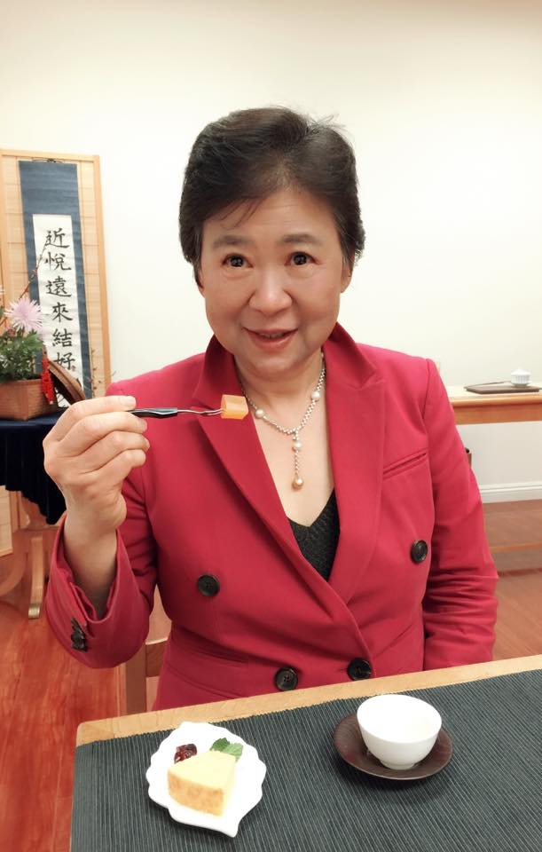
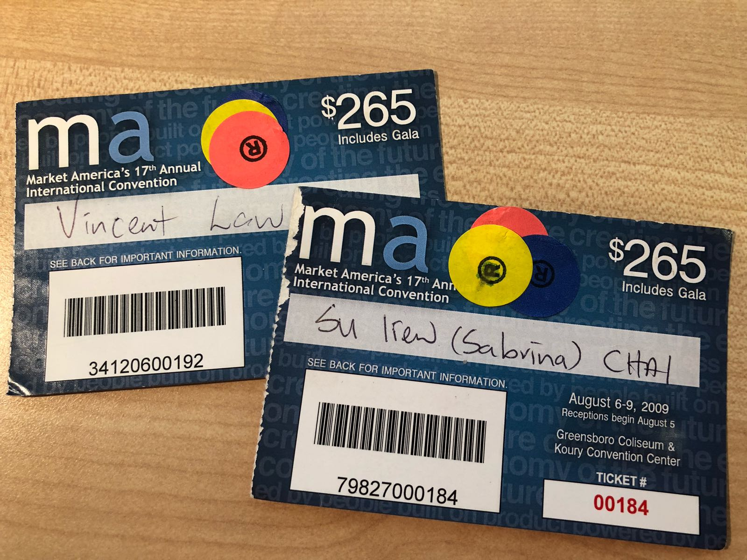
My journey began with 2 Greensboro Convention Tickets
Marian Kuo came to Perth for 3 days
small team in Perth
Just relocated back to Perth - jobless
She sold me 2 tickets to Greensboro Convention
Notes:
3
3
3

Slide 4
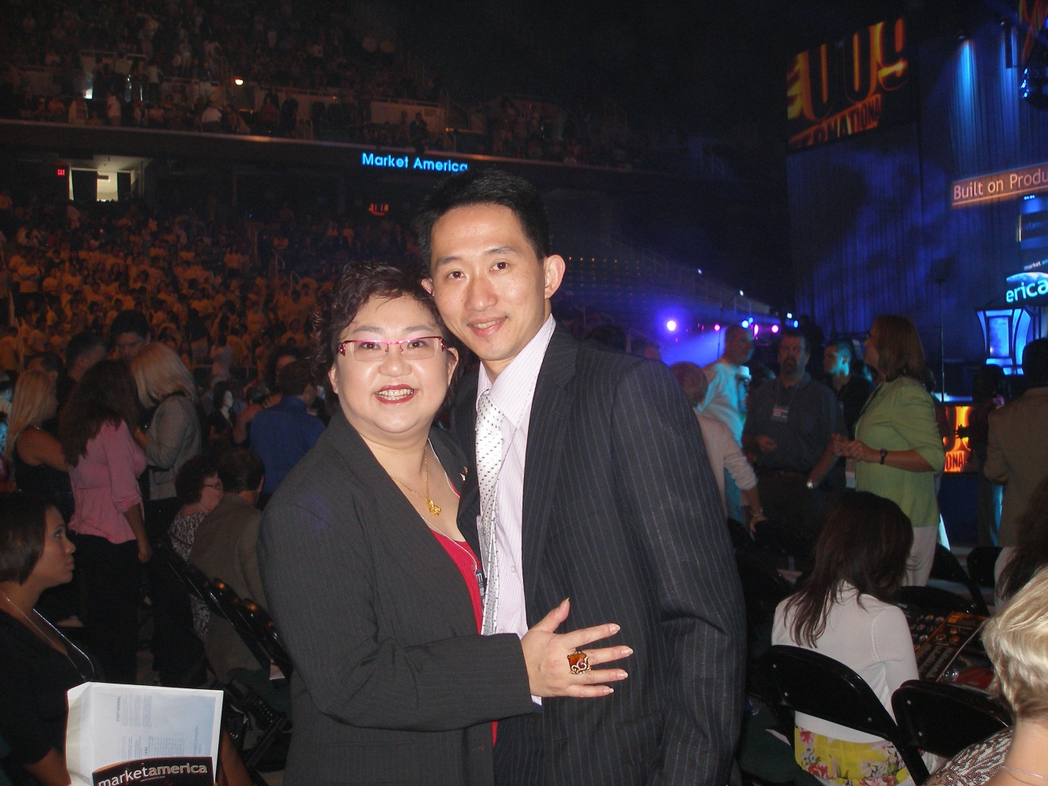
Our first Greensboro convention together
NO
YES
From spare time
Part time
Notes:
4
4
4

Slide 5
Ex piano teacher
Ex Purchasing and Operation Manager
Market America’s Best Trainer of the year 2017
Market Australia’s Best Trainer of the year 2018
Leadership Council Member of Market Australia
Formally Perth UBP and Local Coordinator
ECCT Certified Trainer
Category 2 speaker for Market Australia
Pioneer Team of Market Malaysia
Master UFO multiples times
SAMM multiples times

Slide 7
Best feeling in the world …..
1 BDC = BV $ 78,000
Bonus $31,200
IBV $78,000
TOTAL 001 = 187,200 / yearly
2 BDC = $374,400
3 BDC = $561,600

Slide 8
Duplication
Leverage

Slide 9
Result Producing Activities
Use and Sell the Products
Share the Business
Share the Shopping Annuity
Sell Tickets (Education)

Slide 10
Attitude and Knowledge
Goals and a Goal Statement
Retailing
Basic 5
Prospecting, Recruiting and Sponsoring
Follow Up and the ABC Pattern of Building Depth
Fundamentals of the Business

Slide 11
2-3 years plan
2. Duplication
1. One to One Marketing
UnFranchise Business
Duplicate your effort
Focus on developing 2 sales organisations
Service 10-15 PC
30 – 100% retail profit
Each BDC weekly earning potential A$1500 - $3600
Left sales organisation
Right sales organisation

Slide 12
Master UnFranchise® Owner Program
A Structured System of Success for
Independent UnFranchise Owners

Slide 13
Master UnFranchise® Owner Program
Recruitment
Retailing
Education

Slide 14
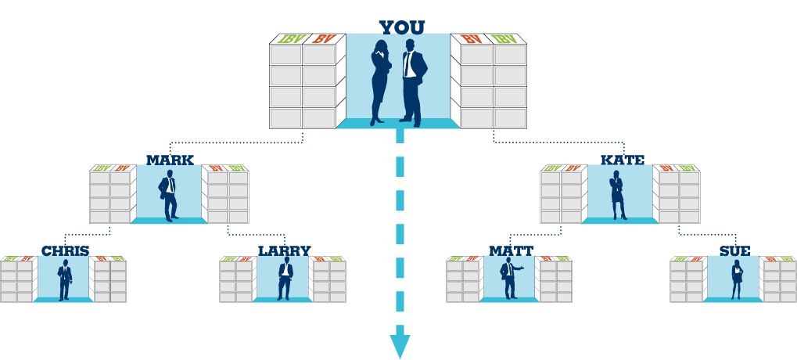
OrganiSation Satisfying the Shopping Annuity®
and base 10, 7 STRONG
Commissions = $8,400 monthly (BV) and $6,000 monthly (IBV)
You should earn $2100 weekly (BV) and $1500 weekly (IBV)
50 UFO’s x 800 BV = 40,000 BV Monthly
Plus
50 UFO’s x 400 IBV = 20,000 IBV Monthly
50 UFO’s x 800 BV = 40,000 BV Monthly
Plus
50 UFO’s x 400 IBV = 20,000 IBV Monthly
BV and IBV banks on this slide display weekly volume accruals

Slide 15
Facing lots of rejections
Rejections from family, close friends, people who know me well ….

Slide 16
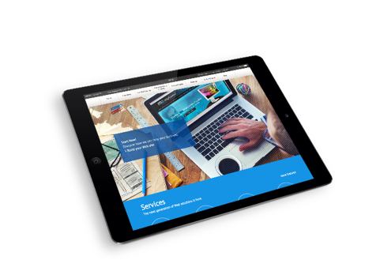
Fast Start Program
AUD$439 – EACH KIT* INCLUDES $129.95 SUBSCRIPTION, 300 BV AND FREE SHIPPING
*products in kits are subject to change

Slide 17
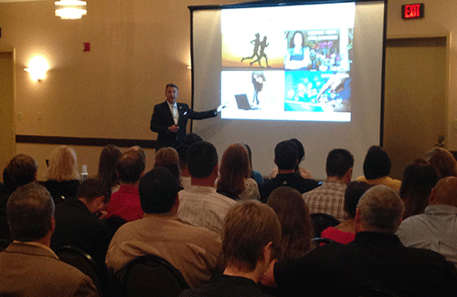
GMTSS
Group Interviews/ Business Lunches
Home Business Presentation
MEETING AFTER MEETING
2-on-1
Webinar
Decision to get started OR answer questions
Meet Successful UnFranchise Owners
UnFranchise® Business Presentation
FOLLOW Up Appt.

Slide 18
General Business Trainings NUOT, Basic 5, ECCT
UnFranchise® Business Presentation (UBP)
University Specific Trainings
TLS, Motives, ISM, WebCenter, etc.
Local Seminars
Annual Convention
International Convention
World Conference

Slide 19
Tasks
10. coring
1. Name list
2.Call W/S
3. Two on One
9. Getting Started Guide
Successful Leader
4. Events
8. GMTSS Events
7. Register
6 .Handle Objection
5. UBP
Notes:
4. Events – HBP, Motives events, Wellness, TLS
8. GMTSS Events – NUOT, Basic 5, ECCT, Local Seminar and Convention

Slide 20
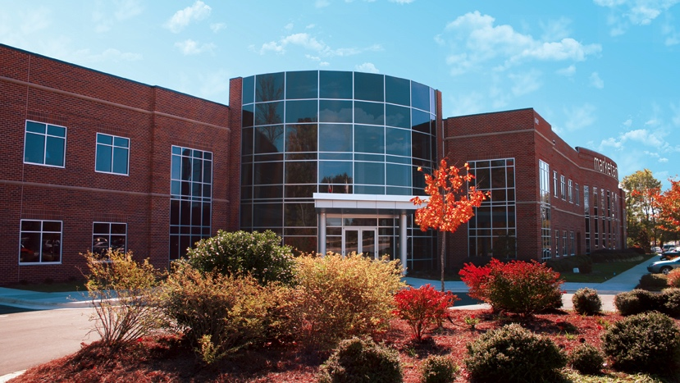
Provides an opportunity for ordinary people to make passive income from generation to generation

Slide 21
Ordinary people are not good at selling
1 to 1 marketing / Product Brokerage
Ordinary people have limited abilities
MPCP /Leverage
Ordinary people do not understand entrepreneurship but have the desire to learn
GMTSS｜MA University concept
Ordinary people have limited funds and time
UnFranchise Business｜Low risk with high return

Slide 22
Good business opportunity. Good company
Great products. Outstanding portal
What is your why?
What are your goals?

Slide 23
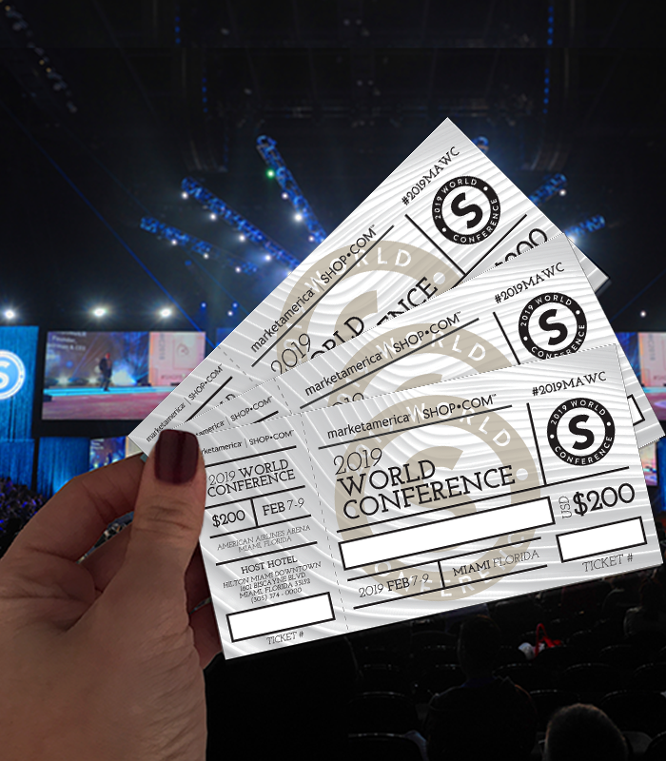
The best way to show your belief -
Your KPI - Tickets
Convention Ticket

Slide 24
The road to success
Belief
Action
Gratitude
Perseverance

Slide 25
The sky’s
The limit!
Wishing all of you a happy Market Australia year!

